Slide 1
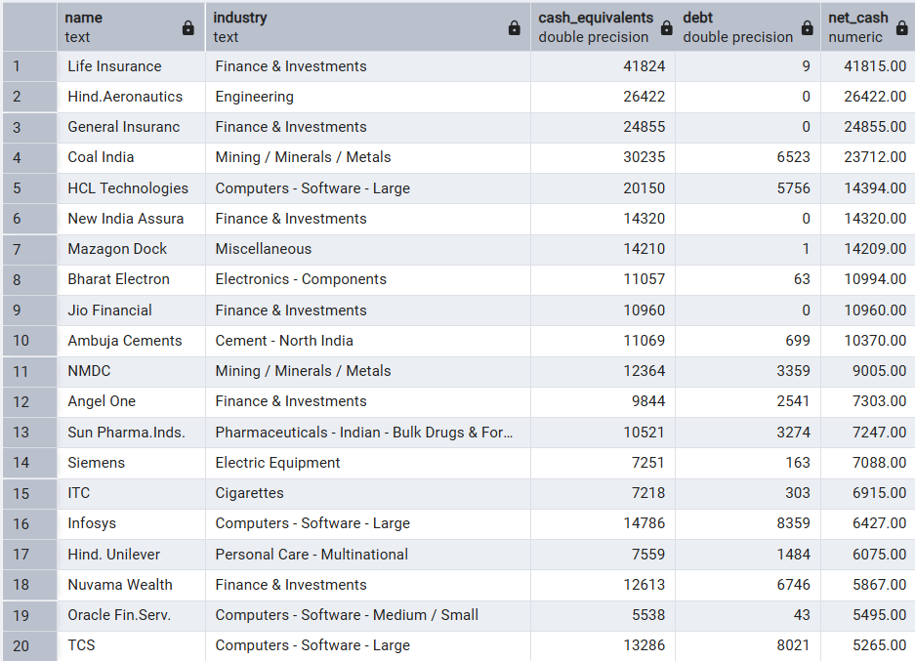
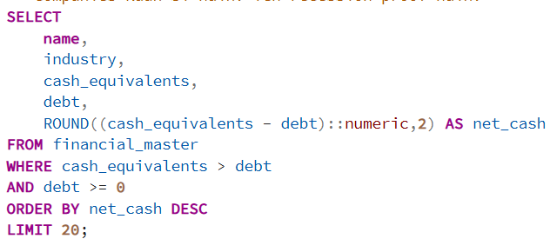
CASH & WORKING CAPITAL
Question: Cash Equivalents vs Total Debt — which companies are cash-rich and debt-free? Are they recession-proof?
Output
Query
Observation:
Life Insurance and General Insurers dominate the list with cash equivalents far exceeding debt
Hind Aeronautics and HCL Technologies represent strong cash positions among non-finance companies
ITC and Infosys appear in top 20 — both known for consistent cash generation
Insight:
Insurance companies naturally hold large cash reserves due to regulatory requirements — their inclusion is structural, not a sign of operational superiority
Technology and FMCG companies like HCL and ITC reflect genuine free cash flow generation — more meaningful from investor perspective
Cash-rich status provides buffer during downturns — these companies can sustain operations, pay dividends, and acquire distressed assets
Recommendation:
Separate financial sector companies from operating companies before using this list for investment decisions
Focus on non-finance cash-rich companies — these are genuine recession-proof candidates
Combine cash richness with ROCE > 15 filter to identify compounders worth holding long term

Slide 2
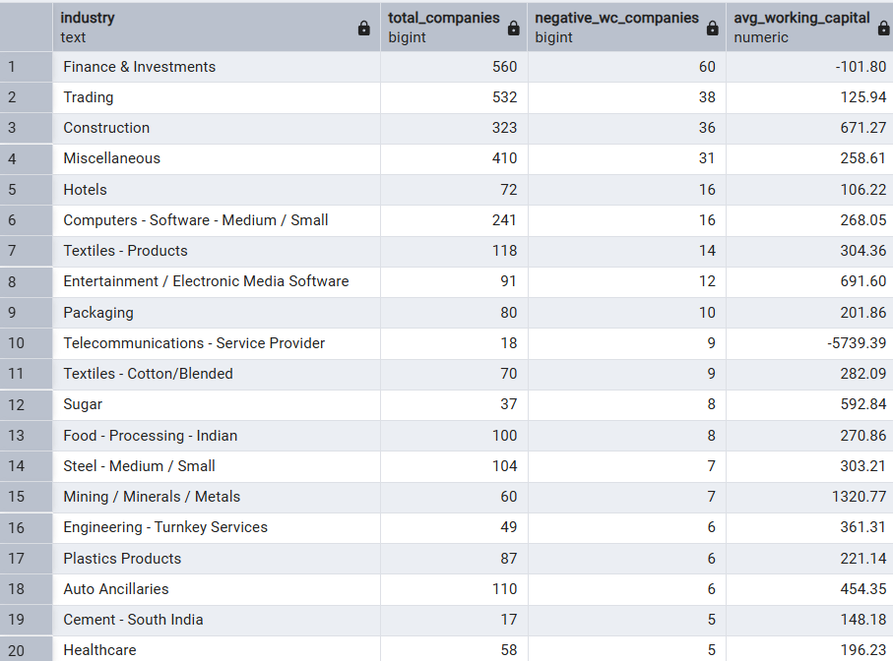
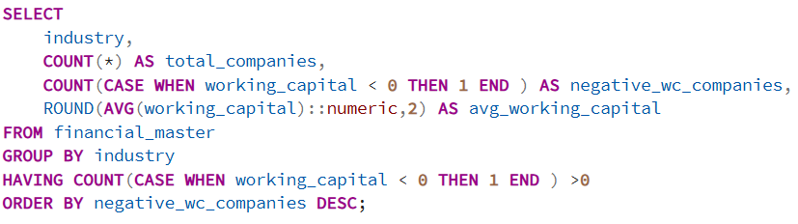
Question: Negative Working Capital companies — in which sectors is this common? Is it good (like FMCG) or bad sign?
Output
Query
Observation:
Finance & Investments dominates with 60 negative working capital companies, followed by Trading (38) and Construction (36)
FMCG and Retail sectors show moderate counts but with favorable average working capital trends
Construction and Miscellaneous sectors show negative working capital alongside poor average figures — structurally different from FMCG
Recommendation:
Always interpret negative working capital in sector context — same number means opposite things in FMCG vs Construction
For Construction companies with negative working capital, cross-verify with debt levels before any conclusion
Build a sector-wise working capital benchmark — flag companies deviating significantly from their own sector median
Insight:
Negative working capital in Finance and Insurance is structural and healthy — float-based business models collect before they pay
In Trading and FMCG, negative working capital reflects strong supplier credit and fast inventory turnover — a competitive advantage
Construction's negative working capital is dangerous — it reflects delayed client payments and cash trapped in incomplete projects

